Slide 1
Final Project: Haptic Glove
Matt Ashcraft
Shelbe Timothy

Slide 2
hap·tic adjective \ˈhap-tik\
1: relating to or based on the sense of touch
2: characterized by a predilection for the sense of touch <a haptic person>

Slide 3
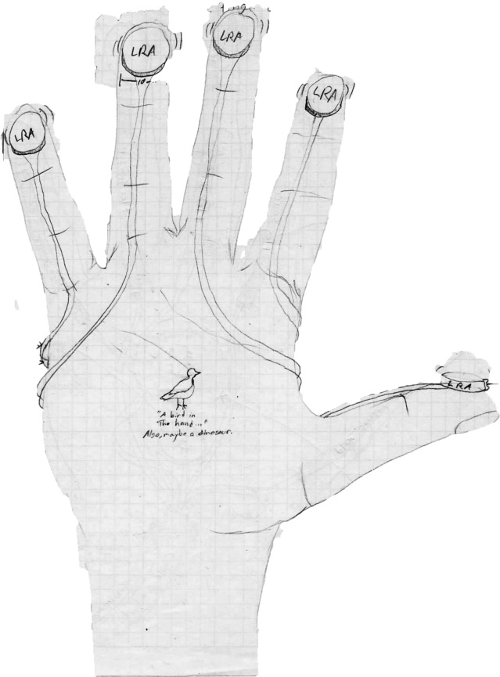
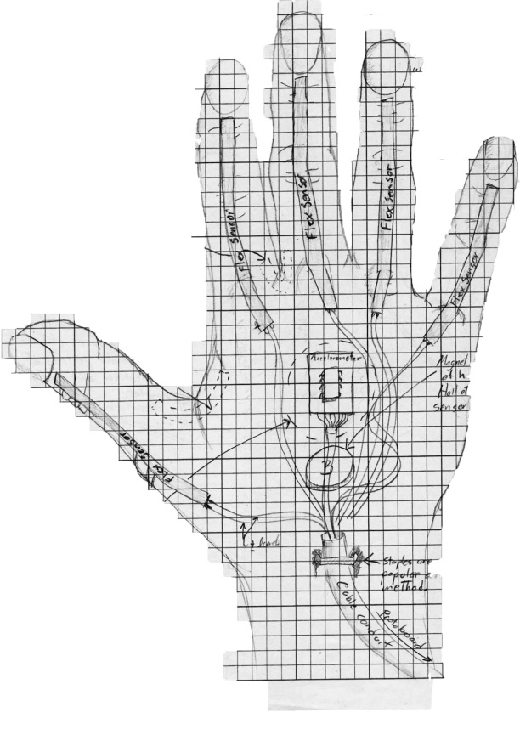
Idea

Slide 4
System Overview
Sensor Array
Signal Processing
Signal Interpretation
Feedback magnitude calculation
Haptic feedback delivery

Slide 5
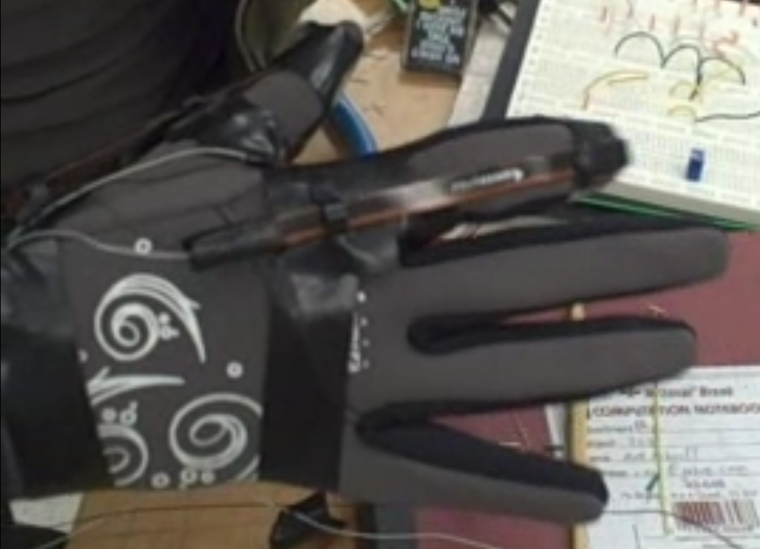
Sensor Array
Sensor Array
Flex sensor array
Human haptic sensor array
Insert flex sensor characteristics, etc.

Slide 6
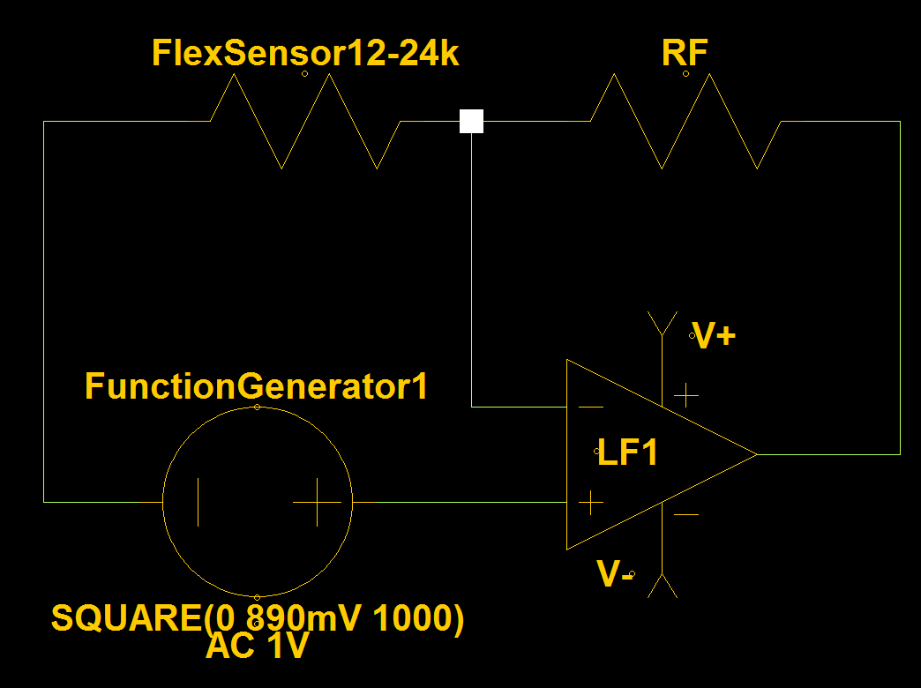
Signal Processing
Flex Sensor Signal Amplification
Insert op amp performance characteristcs and such here.

Slide 7
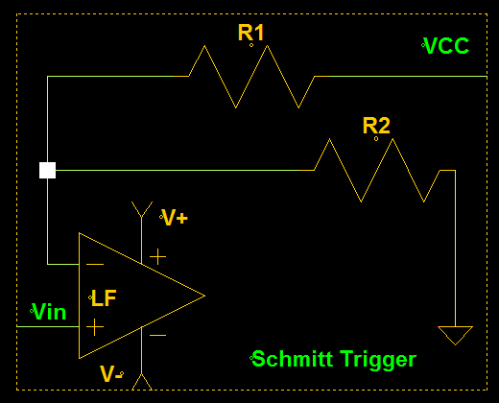
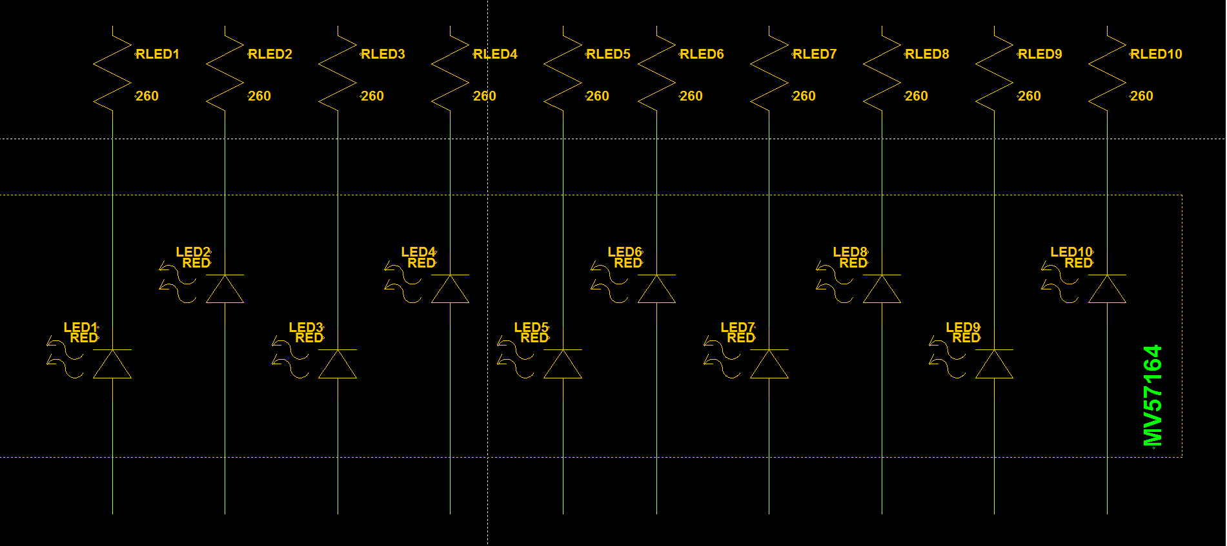
Signal Interpretation
Insert gain formula, and other mathy bits.

Slide 8
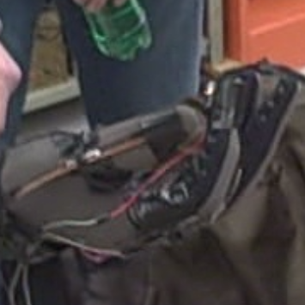
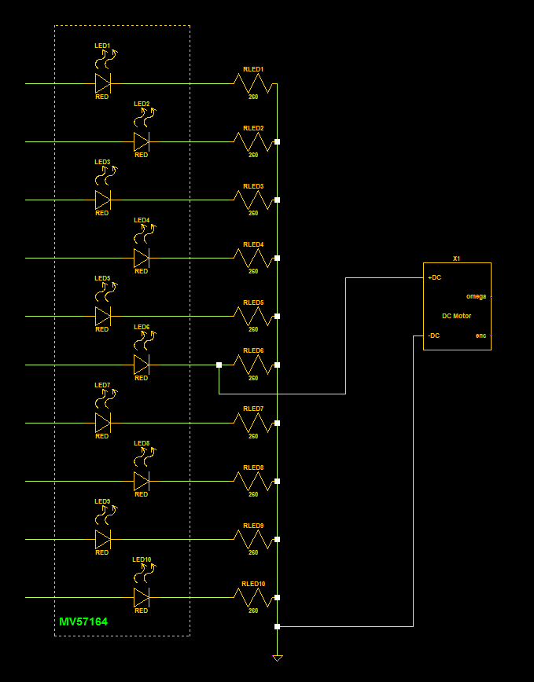
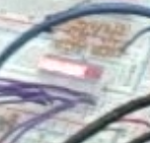
Feedback magnitude calculation
Optimal grasping flex was eyeballed and the ERM was installed in parallel with the corresponding LED on the MV57164.
Need mathy bits explaining amplitude gain on the motor from 6 to 10 since it seems there shouldn’t be any.

Slide 9
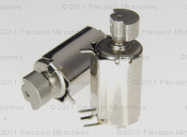
Haptic feedback delivery
Haptic feedback delivery
“The Eccentric Rotating Mass vibration motor, or ERM, also known as a pager motor is a DC motor with an offset (non-symmetric) mass attached to the shaft. ”
We found ours on a shelf in the lab and after a great deal of trial and error attached them to the glove using electrical tape.
If mathy bits are deemed necessary there is a very detailed explanation of ERM characteristics at http://www.precisionmicrodrives.com/application-notes-technical-guides/application-bulletins/ab-004-understanding-erm-characteristics-for-vibration-applications

Slide 10
What worked…
Flex Sensor data measurement and display for thumb and forefinger.
ERM haptic feedback.
Anything else?

Slide 11
What didn’t work…
Logical isolation and signal recombination for ERM driver.
Reason: it was unnecessary. Installing the ERM after the MV57164 provided sufficient haptic feedback for our purposes.
555 PWM circuit
Reason: since we didn’t get the LRAs and the ERMs were simple DC motors we had no need for sculpted pulse trains.
Anything else?

Slide 12
Challenges
Never ignore your supply chain.
British parts= HUGE shipping costs = no LRAs ☹
Prototype PCBs
PCB layout is a discipline unto itself and should not be undertaken without adequate training and software.
3 LF356s died during the making of this circuit. Their sacrifice was not in vain.
Opamp death throes can be strange and difficult to isolate in a complicated circuit.
Anything else?

Slide 13
Surprises…
The mysterious overdriven LEDs.
Starving op amps clip the peaks of your waves then raise the floor.
Potential data density exploit.
Opamps are VERY useful. (Who knew?)
Anything else?

Slide 14
What we wish we’d had time for…
I wish we had time to order the LRAs. The ERMs are useful but not very articulate.
I wish we had time to build out the other fingers.
I wish we had time to build a circuit to account for both x and y coordinates as well as do the math to determine z from x and y.
I wish we had time to build a circuit for the accelerometer.
I wish we had time to build the Hall effect calibration matrix.
I wish we had more time for this presentation…
Anything else?

